Slide 1
Optical properties on the walls of lunar craters larger than 2km
Kilho Baek¹, Sungsoo S. Kim¹, Chae Kyung Sim²
¹Kyung Hee University
²Korea Astronomy and Space Science Institute

Slide 2
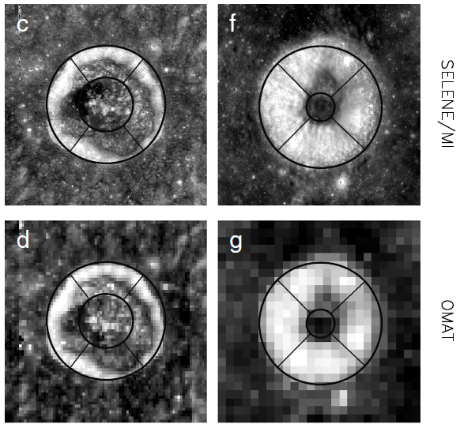
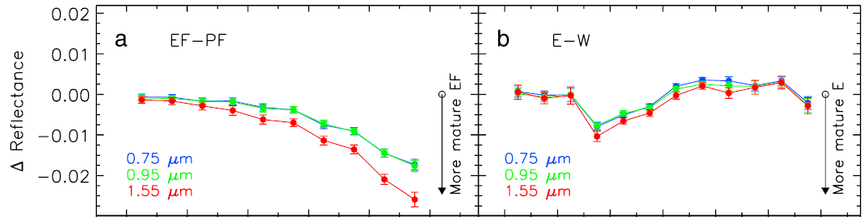
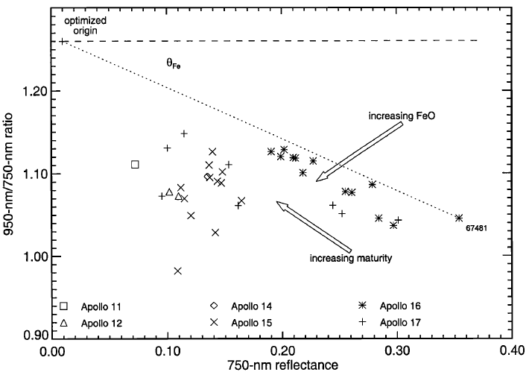
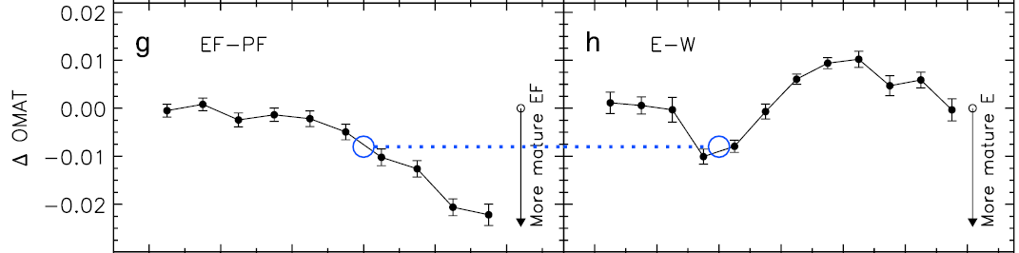
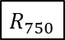
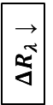
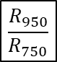

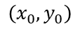


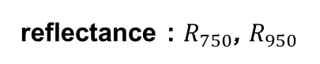
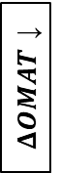

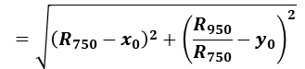
Analysis using crater wall-quadrants
Sim et al. (2017)
Darker Reflectance
Smaller OMAT※
STRONGER
Flux
At northern hemisphere,
North = Equator Facing
South = Pole Facing
Equator
Facing
North
Pole
Equator Facing
West
Eest
※ OMAT : Optical Maturity
The more mature, the smaller OMAT.
(Lucey et al., 2000)
At southern hemisphere,
North = Pole Facing
South = Equator Facing
reflectance : $R_{750}$, $R_{950}$
Pole Facing
optical maturity : $OMAT$
solar wind
Hyper-mature
Pole
Facing
Lucey et al. (2000)
$$\left(x_{0}, y_{0}\right)$$
Lat.
$ΔR_{λ}$ ↓
Equator
$$=\sqrt{{\left(R_{750}−x_{0}\right)}^{2}+{\left(\frac{R_{950}}{R_{750}}−y_{0}\right)}^{2}}$$
$$OMAT$$
$$\frac{R_{950}}{R_{750}}$$
Pole
Facing
$ΔOMAT$ ↓
$$R_{750}$$
Equator Facing
South
Pole
The more mature, the smaller $OMAT$.
Latitude ↑
Longitude

Slide 3
Database & Global Map
 | 2015 DB (LPI) | 2018 DB (Robbins et al.)
Total Number | 8716 | ~ 1.3 million
Main Information | Latitude & Longitude
 | Diameter | Major/Minor-axis
 | Topography | Photometry
Data | Digital Elevation Map(DEM) | Reflectance (415 ~ 1550 nm)
Instrument | LOLA [+ SELENE Terrain Camera] (Lunar Orbiter Laser Altimeter) | MI (Multi-band Imager)
Spacecraft | LRO (Lunar Reconnaissance Orbiter) | SELENE (Selenographical and Engineering Explorer)
Latitude | -60° ~ +60°
Resolution | 512 ppd (≈ 60 m/pixel)
Approximately complete for all craters
larger than about 1-2 km in diameter.

Slide 4
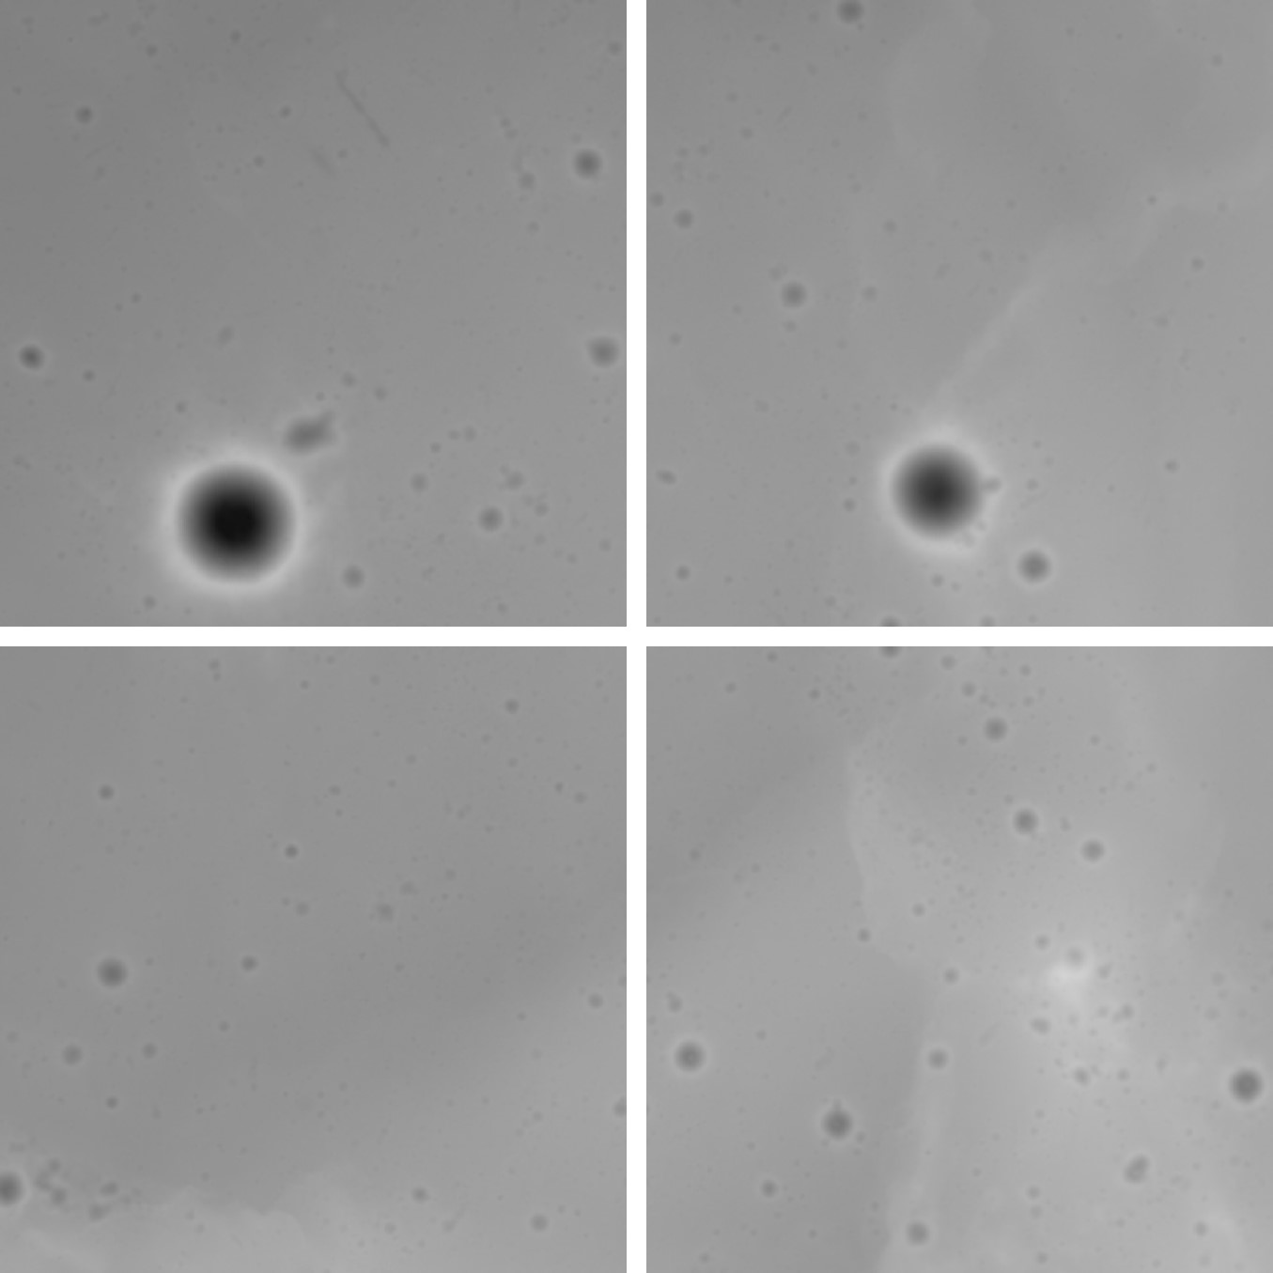
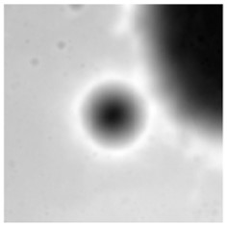
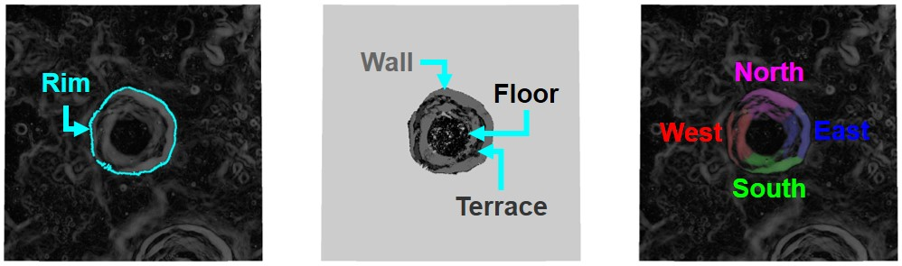
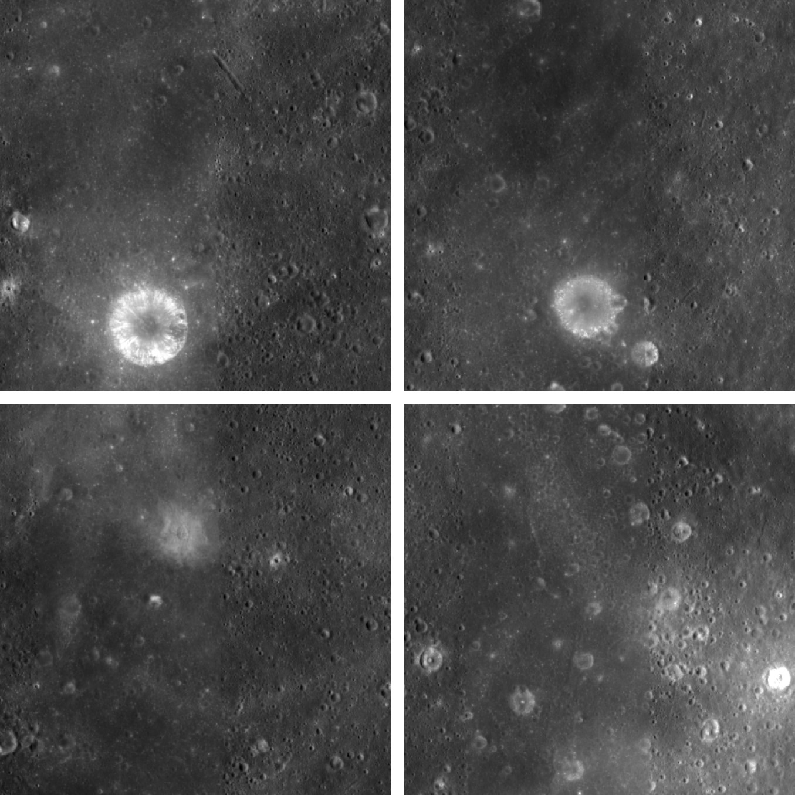
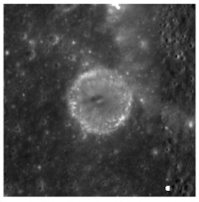
Data Processing
Global Mosaic
Elevation
Morphological Properties
slope
azimuth angle
incident angle
Topography
Global Mosaic
Rim
Inner structure
Wall-quadrants
Sim et al. (2017)
Multi-band Images
(9 bands)
Optical Properties
reflectance
reflectance ratio
reddening
0.95 m depth
optical maturity (OMAT)
iron oxide (FeO)
titanium dioxide (TiO₂)
Photometry

Slide 5
Compared to the previous study
 | Sim et al. (2017) | This study
Database | 2015 DB (LPI) |  | 2018 DB (Robbins et al.)
Samples | 1,872 | 3,513 | 26,802
Diameter | 5 ~ 120 km |  | 2 ~ 150 km
Resolution | 1 km/pixel | 60 m/pixel
Use the extended crater database
Use the higher resolution data & smaller craters
Ensure more statistical significance!
(of course, if the results are consistent with the previous study…)

Slide 6
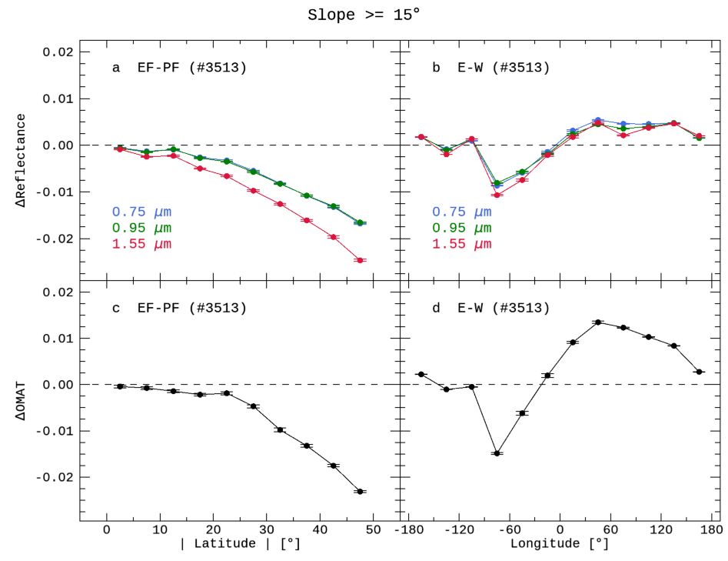
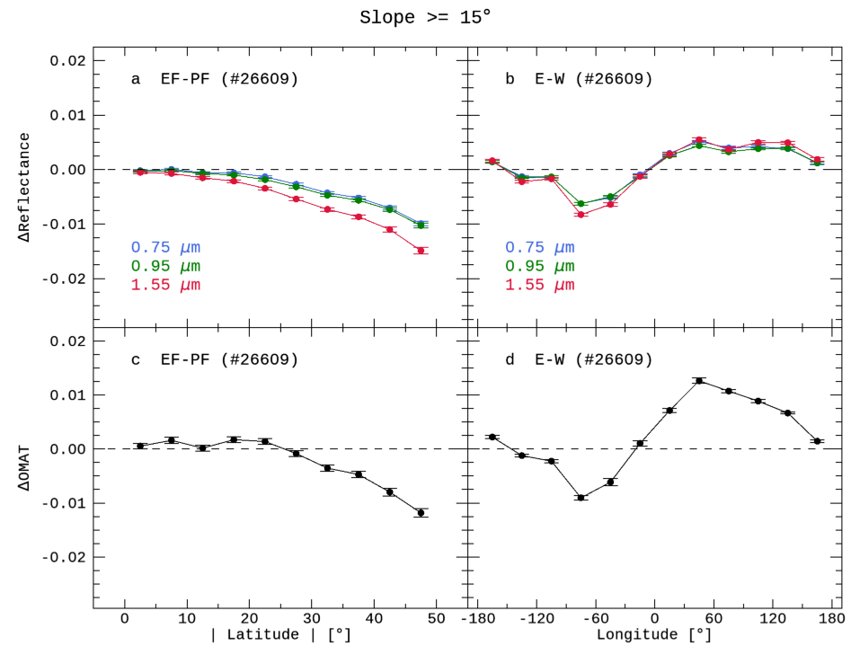
Reproducing the previous study
Sim et al. (2017)
This study (2015 DB) / 5 ~ 120 km
This study (2018 DB) / 2 ~ 150 km
Both database shows
extremely similar results!

Slide 7
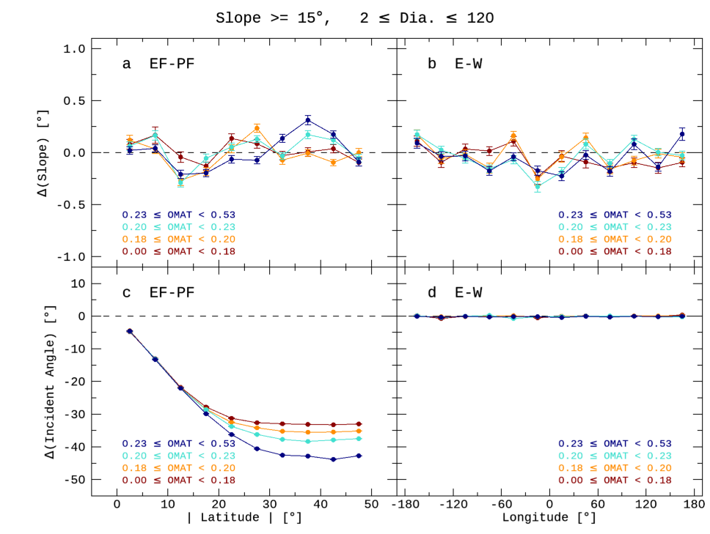

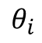
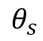

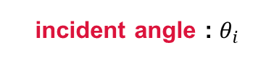
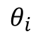
Detailed Analysis (with Morphological Properties)
Change of View!
Spatial analysis
(Latitude, Longitude)
▼
Temporal analysis
(OMAT)
Slope ≥ 15°, 2 km ≤ Diameter ≤ 150 km
slope : $θ_{s}$
incident angle : $θ_{i}$
Normal vector
$$θ_{s}$$
$$θ_{i}$$
$$θ_{i}$$
?
solar wind
mature
Lat.
fresh

Slide 8
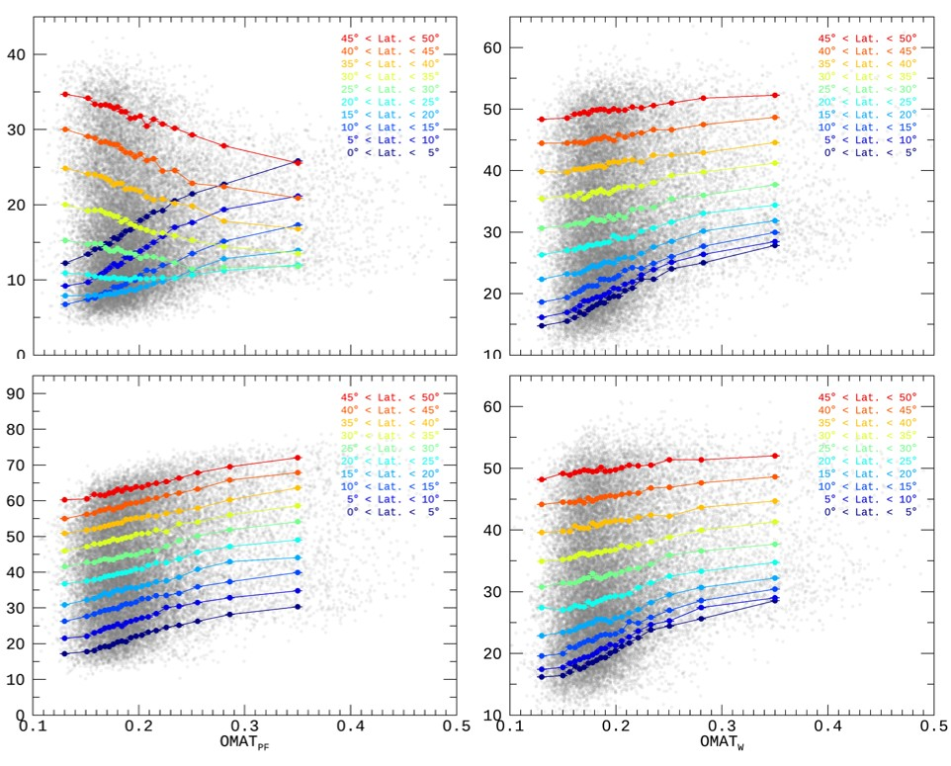
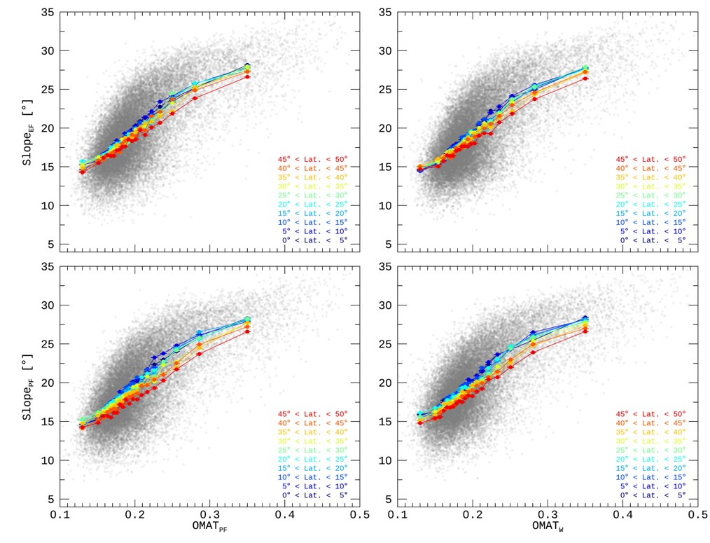
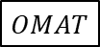
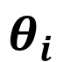
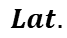
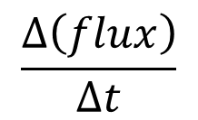
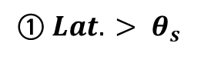
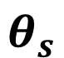
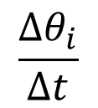
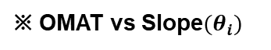
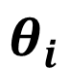
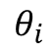
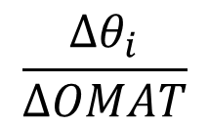
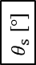
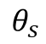
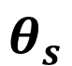
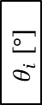
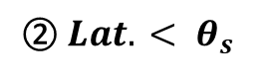
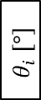
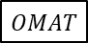
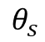
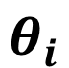
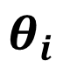
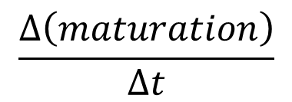
OMAT vs Incident Angle($θ_{i}$)
!
① $Lat. > θ_{s}$
EF
$$θ_{s}$$
EF-wall
E-wall
※ OMAT vs Slope$(θ_{i})$
EF
$$θ_{i}$$
$$θ_{s}$$
$$θ_{i}$$
$$θ_{i} \left[°\right]$$
$$θ_{s} \left[°\right]$$
PF
$$θ_{i}$$
PF
$$\frac{Δθ_{i}}{ΔOMAT}$$
$$\frac{Δθ_{i}}{Δt}$$
$$\frac{Δ\left(flux\right)}{Δt}$$
Steep!
$$\frac{Δ\left(maturation\right)}{Δt}$$
$$Lat.$$
mature
$$OMAT$$
fresh
PF-wall
W-wall
② $Lat. < θ_{s}$
$$θ_{s}$$
EF
$$θ_{i}$$
EF
$$θ_{i} \left[°\right]$$
$$θ_{s}$$
PF
$$θ_{i}$$
$$Lat.$$
$$OMAT$$
$$OMAT$$
PF
mature
fresh
mature
fresh

Slide 9
Summary
Apply the automated and detailed processes —finding rim, defining inner structure, and dividing wall-quadrants.
A total of 26,802 craters ranging from 2 to 150 km in diameter are used.
Ensure higher statistical significance by reproducing the previous study with more samples.
Perform temporal analysis with OMAT as well as spatial analysis.
In the case of east and west wall of craters, the slope decreases faster at low latitude.
Only when slope of crater wall is higher than the latitude, equator-facing wall experiences stronger flux over time.

Slide 10
Research about the Moon
Spacecraft
(In-situ, Sample return)
Geology
(Inside & On)
Astronomy
(Outside & Onto)
Ground-based
(Near-side)
the body
Formation & Evolution
Internal structure
Activity (volcanism, tectonics)
Landscape
Composition
the regolith
Cratering & Weathering
External Environment
Space-weathering
(solar-wind, meteorites, cosmic-ray)
Overall surface
Maturation
Lunar Orbiter
(Global Map)
photometry
topography
radiometry
spectroscopy

Slide 11
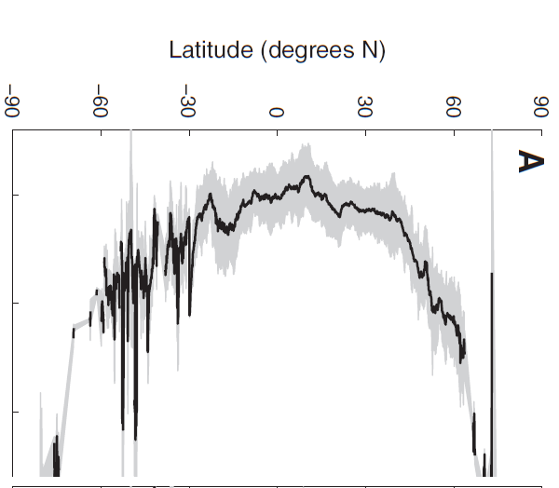
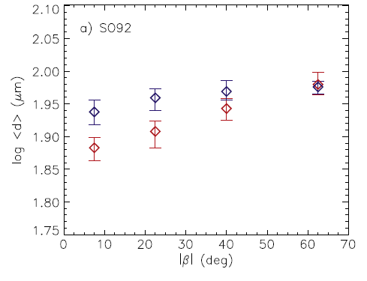
Recent Studies
① Jeong et al. (2015)
② Hemingway et al. (2015)
③ Sim et al. (2017)
By micro-meteorites
By solar-wind particles
By solar-wind particles
[ only near-side, with polarization ]
[ only maria, with swirl ]
[ whole moon, with crater wall ]
Latitude ↑
ΔReflectance ↓
Grain Size ↑
Reflectance ↑
Latitude ↑
Latitude ↑
Lower latitude ➔ Stronger Flux
ΔReflectance ↓
① Smaller Grain size
Stronger
Flux
② Darker Reflectance
Lat.
③ Lower ΔRefelctance
Longitude

Slide 12
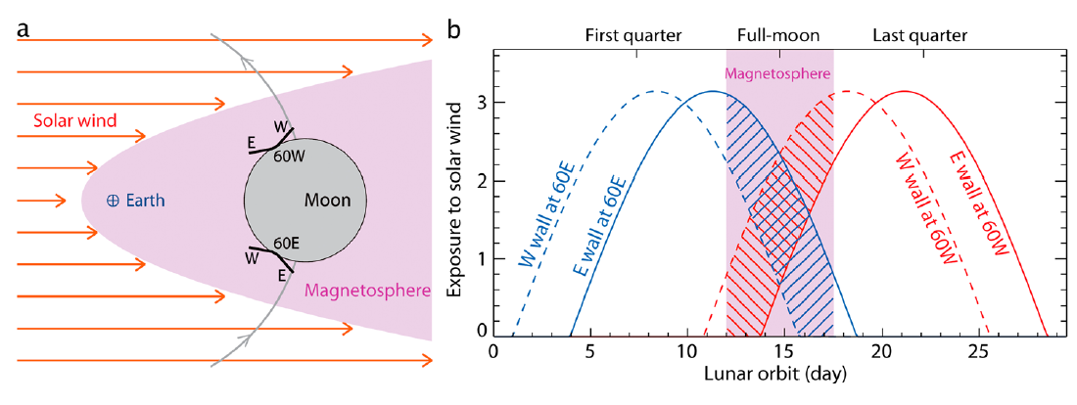


Analysis using crater wall-quadrants
Sim et al. (2017)
Darker Reflectance
Smaller OMAT
North
STRONGER
Flux
Equator
Facing
North
Pole
reflectance : $R_{750}$, $R_{950}$
West
Eest
optical maturity : $OMAT$
$ΔR_{λ}$ ↓
solar wind
Hyper-mature
Lucey et al. (2000)
South
$$\left(x_{0}, y_{0}\right)$$
$$=\sqrt{{\left(R_{750}−x_{0}\right)}^{2}+{\left(\frac{R_{950}}{R_{750}}−y_{0}\right)}^{2}}$$
$$OMAT$$
Pole
Facing
$ΔOMAT$ ↓
$$\frac{R_{950}}{R_{750}}$$
Equator
Lat.
Latitude ↑
Longitude
Pole
Facing
$$R_{750}$$
The more mature, the smaller $OMAT$.
Equator Facing
South
Pole

Slide 13


Algorithms to define features of crater
Rim
Inner structure
Wall-quadrants
Simple
Simple
Complex
Complex

Slide 14









Compared to the previous study
Sim et al. (2017)
This study
Apply the automated and detailed processes
Define more accurate crater wall
Slope between two points
Mean of slopes of all pixels on the wall
$$H$$
$$\left(R_{o}, H_{o}\right)$$
$$Slope=\left(\sum_{i=0}^{N}{S_{i}}\right)/N$$
$$Slope=\frac{H_{o}−H_{i}}{R_{o}−R_{i}}$$
$$S_{i+1}$$
$$\left(R_{i}, H_{i}\right)$$
$$S_{i}$$
$$R$$

Slide 15

Compared to the previous study
Use the extended crater database
2018
DB
Use the higher resolution data & smaller craters
2015
DB
Ensure more statistical significance!
(of course, if the results are consistent with the previous study…)
 | Sim et al. (2017) | This study
Database | LPI (2015) |  | Robbins et al. (2018)
Samples | 1,872 | 3,513 | 26,802
Resolution | 1 km/pixel | 60 m/pixel
Diameter | 5 ~ 120 km |  | 2 ~ 150 km

Slide 16

Detailed Analysis
Slope ≥ 15°, 2 km ≤ Diameter ≤ 150 km
We can do
various analyses by changing diameter to:
small
big
- elevation
- slope
- depth/diameter
- reflectance
- FeO
- OMAT
( But not today :( )

Slide 17
















Which Properties do we use?
Morphological Properties
Optical Properties
slope : $θ_{s}$
reflectance : $R_{750}$, $R_{950}$
incident angle : $θ_{i}$
optical maturity : $OMAT$
Hyper-mature
Lucey et al. (2000)
Normal vector of the wall
$$θ_{s}$$
$$\left(x_{0}, y_{0}\right)$$
solar wind
$$θ_{i}$$
$$=\sqrt{{\left(R_{750}−x_{0}\right)}^{2}+{\left(\frac{R_{950}}{R_{750}}−y_{0}\right)}^{2}}$$
$$OMAT$$
solar wind
$$θ_{i}$$
$$\frac{R_{950}}{R_{750}}$$
Lat.
$$R_{750}$$
The smaller $θ_{i}$, the more flux.
The smaller $OMAT$, the more mature.
Smaller $θ_{i}$
More flux
Darker $R_{λ}$
Smaller $OMAT$.

Slide 18
OMAT vs Slope($θ_{s}$)
Slope decreases
over time
EF-wall
E-wall
$$θ_{s} \left[°\right]$$
Micrometeoritic bombardment
Seismic shaking
Topographic diffusion
Landslides
(Advective mass wasting)
Deposition
(lofted dust or distal ejecta)
Thermal
expansion and contraction
PF-wall
W-wall
$$θ_{s} \left[°\right]$$
mature
$$OMAT$$
fresh
mature
$$OMAT$$
fresh

